Slide 1
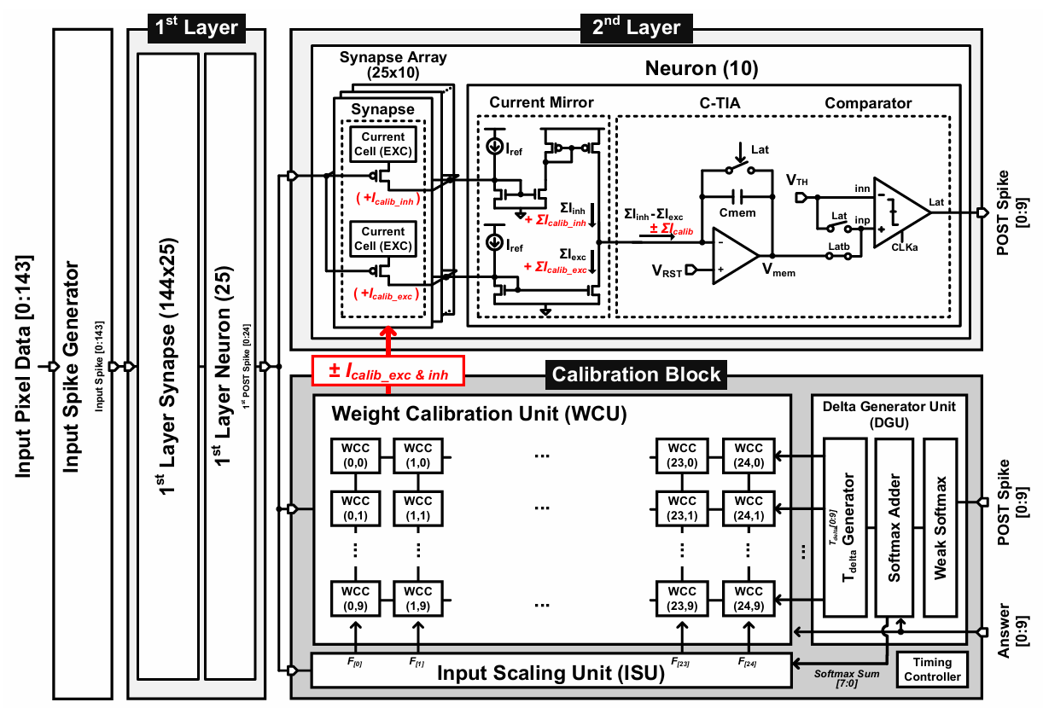
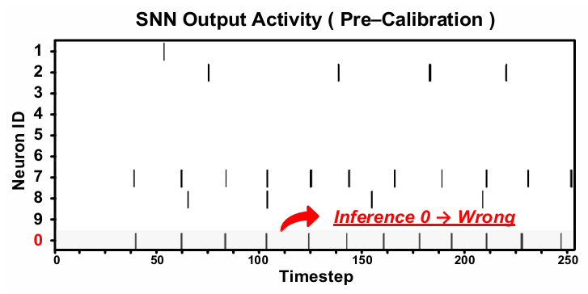
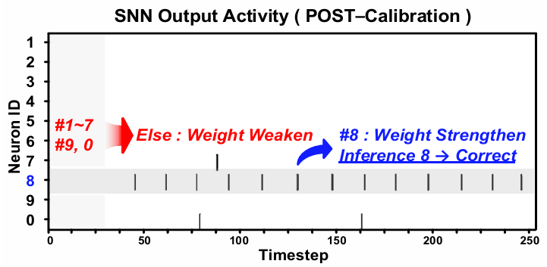
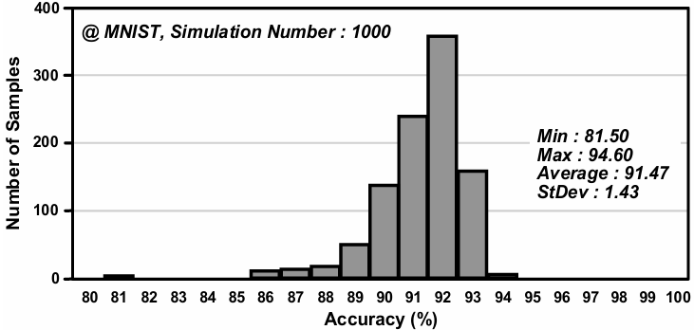
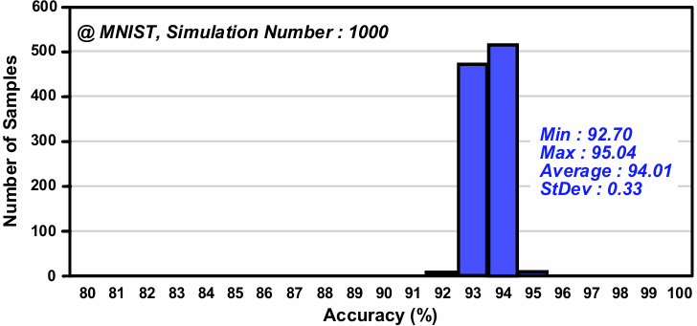
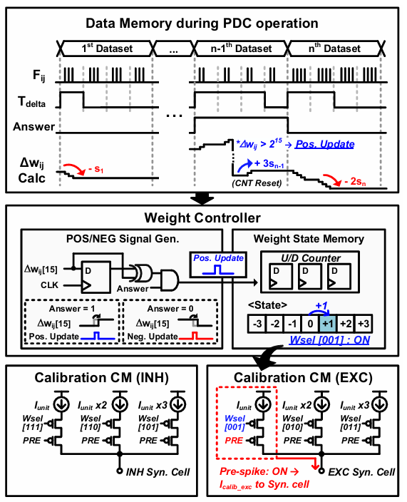
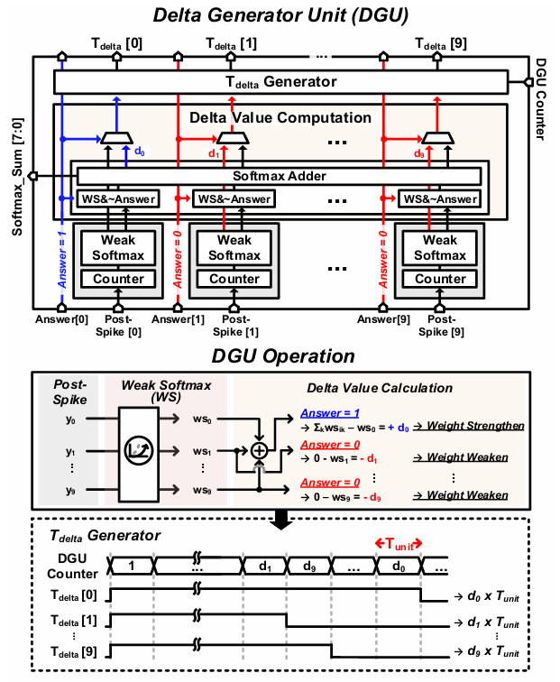
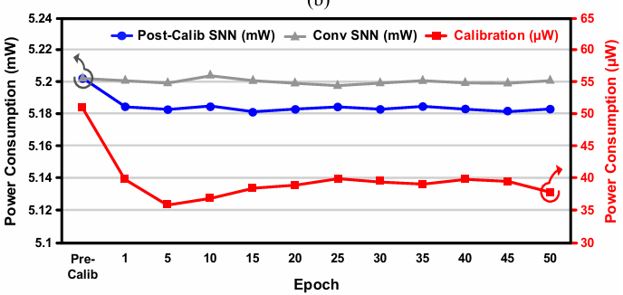
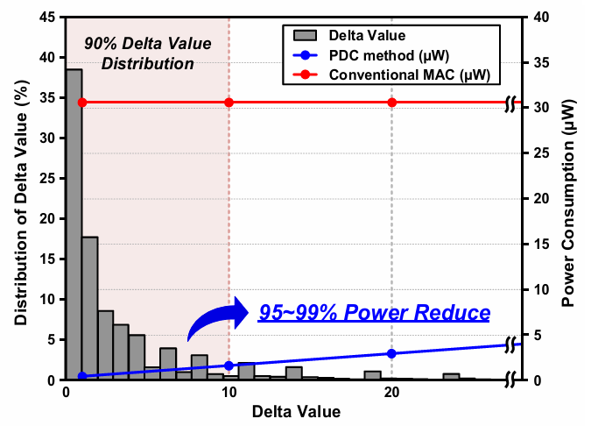
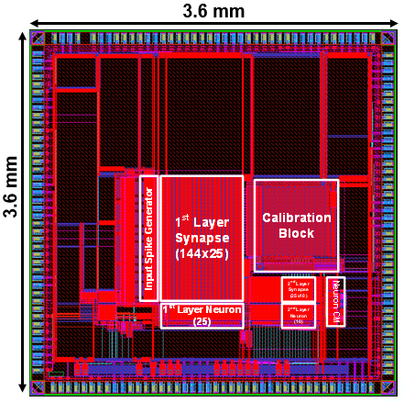
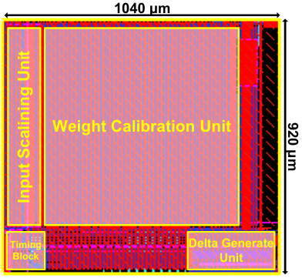
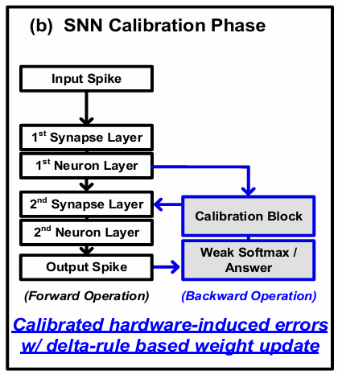
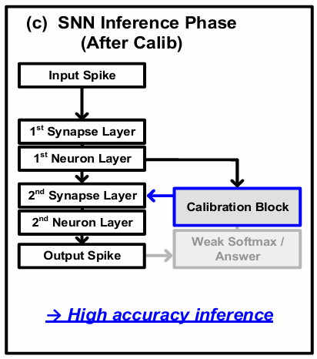


Delta-Rule-based Weight Calibration
for Low-Power SNN System
Seungjoon Lee, Junseo Chae, Jiseok Kwak, Myungsik Kim, Soo Youn Kim, and Minkyu Song
Dept. of System Semiconductor, Dongguk University, Seoul, Korea
E-mail : 2020110519@dgu.ac.kr
Introduction
This work proposes a low-power spiking neural network (SNN) system enabling on-chip calibration with pulse-driven computation (PDC) for weight update based on the delta rule algorithm. The proposed system computes delta weights without multipliers and updates weights via simple pulse counting using counters and logic gates. The proposed system achieves an inference energy efficiency of 0.2pJ/SOP, a calibration efficiency of 3.25 TOPS/W, and an accuracy of 95.04% with MNIST dataset.
Proposed SNN Calibration Architecture
Measurement Results
Before calibration, neuron #0 generates the highest number of spikes(wrong).
After calibration, neuron #8 generates the highest number of spikes(correct).
The MC simulation results demonstrate that the proposed SNN calibration system maintains a reliable classification performance under a wide range of process variations, highlighting its robustness and practical applicability.
As calibration progresses, both the spike count and the magnitude of the delta values gradually decrease, which leads to a steady decline in power consumption.
The proposed method achieves a substantial energy reduction of approximately 95-99% compared to conventional MAC designs.
Chip layout and Summary
In the proposed architecture, a calibration mechanism is applied to the output layer(2nd layer).
Delta Generator Unit(DGU) computes the difference between the weak softmax output of the neuron and the target label based on delta rule.
Weight Control Unit(WCU) is composed of a 25x10 array of weight calibration cells. Each WCC performs the PDC operation based on the pulse signal and pulse width to calculate the delta weight and updates the weight internally, generating a calibrated current as the output.
Specification
Process Tech. | Samsung 28nm CMOS
Supply Voltage | 1.8V(Analog) / 1V (Digital)
Die Area | 3.57 mm²
System Model | SNN / ANN
 | Inference | Calibration
Layer | 144-25-10 | 25-10
Frequency | 10~25MHz | 10~100MHz
Inference Efficiency | 0.2pJ/SOP (MNIST)
Calibration Efficeincy | 155pJ/Train (MNIST) 3.25TOPS/W (MNIST)
Accuracy @MATLAB® | 94.67% (w/o Learning, MNIST) 95.04% (w/ Learning, MNIST)
Proposed SNN Calibration Algorithm Framework
Proposed architecture performs two phase.
In (a) phase, weights is modified based on delta rule.
In(b) phase, inference is proceeded with modified weights.
Acknowledgement
The chip fabrication and EDA tool were supported by the IC Design Education Center(IDEC), Korea.

